Slide 1
Week 4 Part 2
Functions

Slide 2
Week 4 Menu
Designing a Program
Functions

Slide 3

Last Time
Designing a Program:
Break the problem…
into smaller pieces
We will now take that concept
to the next level.

Slide 4

Functions
Chopping our programs into smaller pieces

Slide 5
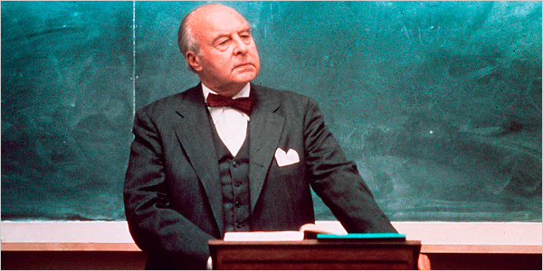
For a moment
Forget about C and C++
Forget about programming
Pretend you are in law school
from the movie "Paper Chase"

Slide 6

Functions are like contracts
There are three elements to a contract:
The contract itself
What it requires (payment)
What it delivers
The "party of the first part"
The entity who initiates the contract...
and who pays…
and who receives the benefit/result.
The "party of the second part"
The entity that executes the contract…
and receives the payment…
and delivers (returns) the benefit/result
to the party of the first part.

Slide 7
Returning to Programming
A function is like a contract.
It must be rigidly defined re: the "payment" and the "result".
A contract is created
One entity initiates the contract
One entity that executes the contract
Payment
Benefit/Result
A function must be called to make it execute.
Arguments are passed to the function.
A function executes when it is called. It receives arguments.
It returns a single result.

Slide 8
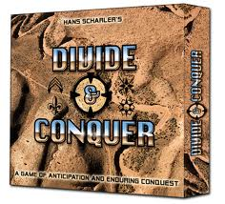
Functions: Why?
The basic philosophy:
divide and conquer
complicated tasks are successively divided into simpler and more manageable tasks
which can be:
easily understood
easily changed
easily re-used.
And:
if you do something again and again…
call a function to do it
vs. writing the code over and over

Slide 9
Functions: What
What is it?
A function is:
a block of code
that has a name
and
that has a type
and
that optionally receives arguments (also known as parameters)
and
that sends back a return value (based on type)*
and
must be called (initiated) from as many different points in a program as required
* functions of type void do not return a value

Slide 10
Functions: Words
Terminology:
A function must be defined (in a declaration)
A program uses a function by calling it
The calling program may pass arguments to the function
Arguments are also called parameters
The function receives arguments/parameters from the calling statement
The function may return a value
Parameters
calling
function
executing
function
Return Value

Slide 11

Functions: So far
Functions you've seen so far:
main()
rand()
srand(seed)
cout
cin
setw(3)

Slide 12
Functions: Rules
Para-meter
list
name
type
No ;
A function has
a definition, with:
A type (void, int, double, etc.)
A name
Must start with a letter
Can't be a keyword
A parameter list ( ) with optional defined parameters
No semicolon
int funfunfun( char var1)
{
int nofun;
if ( var1 == 'f' )
nofun = 1;
else
nofun = 0;
return nofun;
} // end of funfunfun

Slide 13
Functions: Rules
A function has
a body
With brackets
With a return statement
Unless the function is type void
Then return is optional, but a good idea
Parameters become new variables in the body of the function
int funfunfun( char var1)
{
int nofun;
if (var1 == 'f')
nofun = 1;
else
nofun = 0;
return nofun;
} // end of funfunfun

Slide 14
Functions: Calling
int main()
{
char c = 'j';
int x;
x = funfunfun(c);
return 0;
} // end of main
int funfunfun( char var1)
{
int nofun;
if (var1 == 'f')
nofun = 1;
else
nofun = 0;
return nofun;
} // end of funfunfun
Call a function:
The function name is a statement
Include parameters if necessary
Use a semi-colon

Slide 15
Functions:Calling
int main()
{
char c = 'j';
int x;
x = funfunfun(c);
return 0;
} // end of main
int funfunfun( char var1)
{
int nofun;
if (var1 == 'f')
nofun = 1;
else
nofun = 0;
return nofun;
} // end of funfunfun
Call function funfunfun and pass value of variable c
j
A copy of the value of c (whose value is 'j') is passed to funfunfun and assigned to the parameter var1
0
In funfunfun, var1 (which equals 'j') is evaluated
var1 does not equal 'f', so else statement assigns value of 0 to variable nofun
The value of variable nofun (which is 0) is returned to the calling function (main)
The calling function (main) receives the return value (0) – this value is then assigned to x.

Slide 16
Another Rule:
Function Prototype:
A definition of the function
With a semicolon
Must go before the function is called
Must not be inside a function
Generally goes at the top of the program
// A function prototype
int funfunfun( char var1);

Slide 17
Function Prototype
Why?
Informs the compiler:
that there will be a function
of a certain type
of a certain name
With a certain set of parameters
Think of it as "preview of coming attractions"
Coming Soon!

Slide 18

Function Prototype
Why do I have to write prototypes?
So you don’t have to put functions in front of the functions that call them
I hate prototypes.
fun1()
fun2()
main()
What if fun1 calls fun2 ?

Slide 19
Function Prototype
#include <iostream>
using namespace std;
// function prototype
int funfunfun( char var1);
int main()
{
char c = 'j';
int x;
x = funfunfun(c);
return 0;
} // end of main
int funfunfun( char var1)
{
int nofun;
if (var1 == 'f')
nofun = 1;
else
nofun = 0;
return nofun;
} // end of funfunfun
Prototype
main() should be the first function

Slide 20
Tip
#include <iostream>
using namespace std;
// function prototype
int funfunfun( char var1);
int main()
{
char c = 'j';
int x;
x = funfunfun(c);
return 0;
} // end of main
int funfunfun( char var1)
{
int nofun;
if (var1 == 'f')
nofun = 1;
else
nofun = 0;
return nofun;
} // end of funfunfun
Write your prototype first
Copy it
Paste it at the declaration location
Remove the ;
Add the { } brackets (and comment)
Paste it at the calling location
Change the parameter list in the call
Be sure to remove the types in the call
1
2
7
6
4
3
5
5

Slide 21

Functions:
Watchouts:
A prototype has a semi-colon, a declaration doesn’t
The call has a semi-colon
The call passes parameters; it doesn’t define them
The declaration defines parameters
the prototype matches
You can call parameters the same name in the call and in the function
or not…
it doesn’t matter
// function prototype
int funfunfun( char var1 );
// function call
x = funfunfun(c);
// function declaration
int funfunfun( char var1)
{
// function block
}

Slide 22
Functions: Example
See:
Sample 5
ContinueYesNo.cpp
Posted on Blackboard

Slide 23
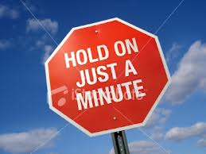
Hold on just a minute…
Didn't you say
"A function can only return one value?"
Yes, that is true
A function can only return one value.
But, what if the function needs to return two or more things?

Slide 24
Example
A function to convert a single digit number to its character equivalent:
convert 5 to '5'
convert 7 to '7'
convert2char( 8 ); // pass an 8, get an '8' back
…
char convert2char( int number)
{
// convert a number to a char
char charequiv = number + 48 ;
return charequiv ;
}
Looks good, right?
Dec | Char
48 | 0
49 | 1
50 | 2
51 | 3
52 | 4
53 | 5
54 | 6
55 | 7
56 | 8
57 | 9

Slide 25

Example
So, what's the problem?
If number is larger than 9, it will either
Convert incorrectly:
10 will convert to 58 which is ASCII ':'
Crash:
char is one byte,
max is 255,
so if number is 599, too big for a char, crash
Would like to return:
The converted number (if possible)
A success/error code

Slide 26
Example
How to do it:
Pass in another variable
into which the result (if possible) will go
Like this:
char convert2char( int number, char &result )
Return a success/failure code
bool success; // true if successful, false if not
Do you see the & in the parameter list?
Pass by reference

Slide 27

Passing Parameters
Two ways to do it:
Pass by value
Makes a copy of the value and passes it
Pass by reference
Passes the address of the variable
The function can change it

Slide 28

Functions
Call by Value:
Parameters can send & receive values
Values are passed
from the calling function
To the receiving parameters of the function
The values are copies.
void main()
{
int var1 = 2;
int var2 = 7;
NewFunction (var1, var2); // call
}
void NewFuntion (int varX, int varY)
{
varX = 77; // var1 is still 2
}
The value 2 is copied from var1 to varX.
The value 7 is copied from var2 to varY.
2
7

Slide 29
Functions
Call by Reference:
Parameters can send & receive references
A reference to the variable is passed
from the calling function to the receiving parameters of the function
The variables represent the same memory location.
The called function can modify the originals.
void main()
{
int var1 = 2;
NewFunction (var1); // call
}
int NewFuntion (int &varX)
{
varX = 77; // now, var1 contains 77
}
var1 and varX refer to the same memory location. Change the value of varX and you change the value of var1.
Pass Address

Slide 30
Back to our Example
char result;
convert2char( 8, result ); // call: pass an 8, get an '8' back
…
bool convert2char( int number, char &result )
{
bool success ;
if ( ( number >= 0 ) && (number <= 9 ) )
{
success = true;
result = number + 48 ; // convert a number to a char
}
else
{
result = 0; // set result to 0
success = false;
}
return success;
}

Slide 31
Did you just add something?
YES
&& means "AND"
if ( ( number >= 0 ) && (number <= 9 ) )
{
// do this id expression is true
}
if number is >= to 0 AND number is <= 9
then if expression evaluates to true
if either one is false, then the expression is false

Slide 32
So, while we're at it…
OR
|| means "OR"
if ( ( number >= 0 ) || (number <= 9 ) )
if either number is >= to 0 OR number is <= 9
then if expression evaluates to true
if both one are false, then the expression is false

Slide 33
Be careful
&& means AND
|| means OR
&& is not the same as &
& does boolean AND on the bits (bitwise AND)
3₁₀ & 5₁₀ = 011₂ & 101₂ = 001₂ = 1₁₀
|| is not the same as |
| does boolean OR on the bits (bitwise OR)
3₁₀ | 5₁₀ = 011₂ | 101₂ = 111₂ = 7₁₀

Slide 34
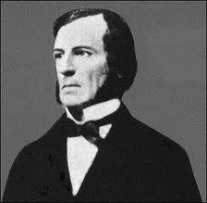
More Boolean stuff later
George Boole

